Slide 1
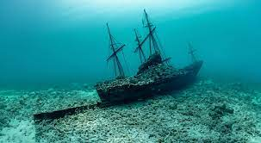
How to salvage a sunken ship

Slide 2
211, 560 wrecks 180, 890 positions

Slide 3
below ￡ 28 million: 8:2 more than￡ 28 million -> 5:5 more than￡ 319 million -> 4:6

Slide 4
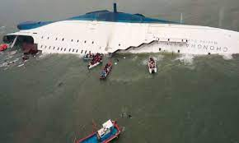

Slide 5
